Slide 1
SORTING VISUALIZER
Represented by: Pritirekha Panda

Slide 2
INTRODUCTION
The Sorting Visualizer is an interactive web-based tool that allows users to see sorting algorithms in action. It provides a hands-on experience for understanding how different sorting algorithms work.
The Sorting Visualizer is created using HTML, CSS, JavaScript, and Data Structures and Algorithms, where HTML provides structure, CSS offers styling, JavaScript handles interactive functionality, and DSA contributes the logic for sorting algorithms.
Sorting algorithms are step-by-step procedures used to arrange elements in a specific order, typically based on numerical or lexicographic criteria.

Slide 3
Objectives:
Interactive Learning Platform: The Sorting Visualizer is an interactive educational tool designed to provide a visual representation of sorting algorithms in action. It offers users a hands-on experience to observe how different sorting algorithms rearrange data in real-time, fostering a deeper understanding of their mechanisms and efficiency.
Demonstration of Algorithmic Concepts: The visualizer helps users to understand fundamental algorithmic concepts such as time complexity, comparison-based sorting, and the differences between various sorting algorithms.
Practical Application of Technologies: The Sorting Visualizer showcases the practical application of HTML, CSS, and JavaScript in building interactive web-based applications. It provides a tangible example of how these technologies collaborate to create functional and visually appealing interfaces.
Engagement and Exploration: Through the Sorting Visualizer, users can actively engage with the interface by selecting different sorting algorithms, adjusting speeds, and observing how these choices impact the sorting process. This interactivity encourages exploration and experimentation with various sorting techniques, enhancing the learning experience.

Slide 4
Implementation of Sorting Visualizer using HTML, CSS, and JS Basics
HTML
HTML (Hypertext Markup Language) is used for creating the structure of a web page. It uses tags to define the different elements such as headings, paragraphs, images, links, and more. HTML provides the foundation for the content of a web page.
CSS
CSS (Cascading Style Sheets) is used for styling the web page. It allows you to define the appearance of HTML elements, such as the layout, colors, fonts, and more. CSS provides the visual design and presentation of a web page.
JS
JS (JavaScript) is used for adding interactivity and functionality to the web page. It allows you to create dynamic and interactive elements, handle user input, manipulate the content of the page, and more. JS enhances the user experience and adds functionality to the web page.

Slide 5
Explanation of Data Structures:
Definition and Importance of Data Structures in Sorting : Data structures are ways to organize and store data efficiently. They play a vital role in sorting algorithms, enabling optimized access, manipulation, and retrieval of data.
Examples of Data Structures Used in Sorting Algorithms: Data structures such as arrays, linked lists, binary trees, and heaps enhance the performance of sorting algorithms by providing efficient ways to store and access the elements being sorted, enabling faster comparisons and rearrangements.
How Data Structures Enhance the Efficiency of Sorting Algorithms: By leveraging appropriate data structures, sorting algorithms can minimize time complexity and space requirements, resulting in faster and more resource-efficient operations.

Slide 6
Sorting Algorithms
Bubble Sort:
Overview: Bubble sort repeatedly steps through the list, compares adjacent elements, and swaps them if they are in the wrong order.
Process: The larger elements "bubble" to the top gradually, hence the name.
Complexity: Time complexity - O(n^2) in the worst and average cases, O(n) in the best case (when the list is already sorted).
Notes: Simple and easy to implement but inefficient for large datasets.

Slide 7
Selection Sort:
Overview: Selection sort divides the input list into two portions: sorted and unsorted. It repeatedly selects the smallest element from the unsorted portion and swaps it with the first unsorted element.
Process: The sorted portion grows while the unsorted portion shrinks until all elements are sorted.
Complexity: Time complexity - O(n^2) regardless of input.
Notes: Simple implementation, but still not suitable for large datasets due to its quadratic time complexity.

Slide 8
Insertion Sort:
Overview: Insertion sort builds the final sorted array (or list) one item at a time. It takes each element and places it in its correct position relative to the elements before it.
Process: It iterates through the list, shifting elements as needed until the entire list is sorted.
Complexity: Time complexity - O(n^2) in the worst case but performs well with nearly sorted or small datasets.
Notes: Efficient for small datasets and often used in practice for its simplicity.

Slide 9
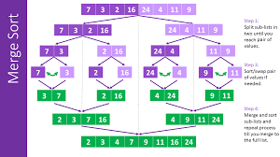
Merge Sort:
Overview: Merge sort is a divide-and-conquer algorithm. It divides the input list into smaller sub-lists, sorts these sub-lists, and then merges them back together to create the sorted list.
Process: It repeatedly divides the list in half until each sub-list contains only one element, then merges them in sorted order.
Complexity: Time complexity - O(n log n) in all cases (worst, average, and best).
Notes: Efficient and stable algorithm suitable for sorting large datasets.

Slide 10
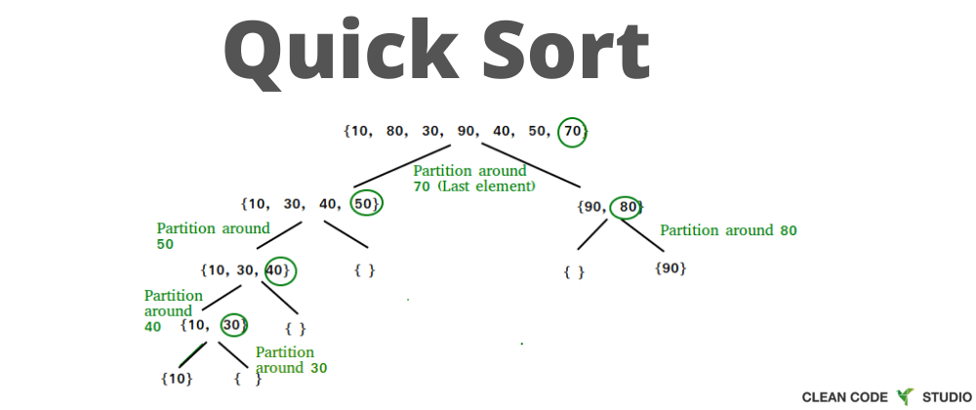
Quick Sort:
Overview: Quick sort is also a divide-and-conquer algorithm. It selects a 'pivot' element and partitions the array around the pivot, such that elements smaller than the pivot are on the left and larger elements are on the right. It then recursively applies this process to the sub-arrays.
Process: It continues dividing and sorting recursively until the entire list is sorted.
Complexity: Time complexity - O(n log n) in the average case, O(n^2) in the worst case (rare, but can happen with poor pivot selection).
Notes: Efficient for average and best cases, widely used due to its average-case performance.

Slide 11
COMPARISION
Quicksort and Mergesort are typically faster and more efficient than Bubble Sort, Insertion Sort, and Selection Sort, especially for larger datasets, due to their average time complexities of O(n log n). Quicksort is often faster for average and best-case scenarios due to its in-place partitioning and cache efficiency, while Mergesort, despite using additional memory, guarantees consistent performance regardless of the input data.

Slide 12
CONCLUSION
A sorting visualizer is a powerful educational tool that offers a dynamic, intuitive representation of sorting algorithms in action. By visually demonstrating how these algorithms rearrange elements in real-time, it provides an engaging and accessible way for learners to comprehend the inner workings, efficiencies, and differences between various sorting methods. This interactive tool not only fosters a deeper understanding of sorting concepts but also cultivates an appreciation for algorithmic efficiencies and their real-world applications, making complex sorting algorithms more approachable and comprehensible.

Slide 13
THANK YOU

